Slide 1
Product Owning a DS thing
Thoughts on Data Science for non-scientists

Slide 2
You won’t get away with zero maths
You manage progress using metrics expressed mathematically
When you liaise accuracy with your customers your job is to translate hard maths into easy maths
Mathematical concepts surround you; they are your KPIs

Slide 3
Coefficient of Determination
r² is the proportion of the variance in the dependent variable that is predictable from the independent variables

Slide 4
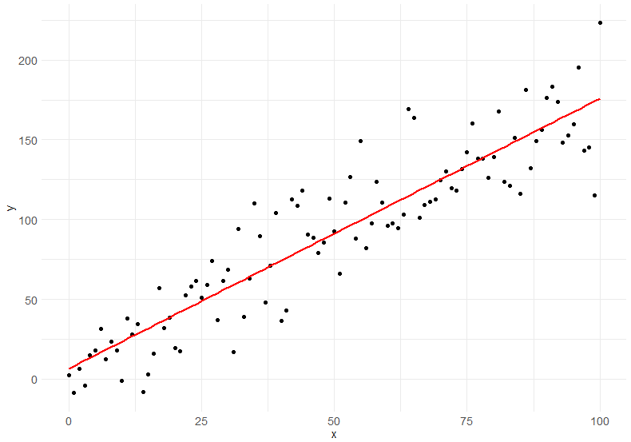
How good a fit is my line?

Slide 5
Compared to….

Slide 6
Compared to….

Slide 7
Compared to….

Slide 8
What does it tell us?
In a multiple-regression model to determine solar energy production:
The energy production is the dependent variable (Y)
The cloud cover level is an independent variable (X1)
The season of year is an independent variable (X2)
Y = X1*weightX1 + X2*weightX2
It’s a coefficient (ratio) of how good my predictions are versus the amount of variability in my dependent variable.

Slide 9
How does it do that?
It measures the relationship between two variables:
Y-hat : ŷ
The estimator is based on regression variables, Intercept, X Variable 1 to X Variable n
The distance from this estimator (prediction) and the real y value (y- ŷ)
Squared
Y-bar : ȳ
The average value of all Ys
The distance of the real y value from the mean of all y values (y-ȳ), which is how much the data varies from average
Squared
These two squares are summed, and calculated:
1-(((y-ŷ)^2)/((y-ȳ)^2))
1-(estimation error/actual distance from average)

Slide 10
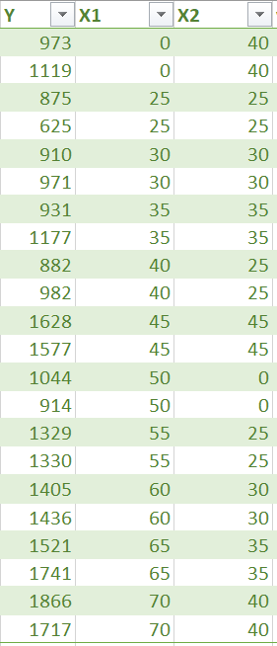
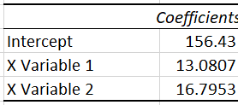

Y is our actual value: Energy generation
X1 is our first input value we want to predict from, X2 our second: Irradiance Percentage and Days left until service
The data science team works hard to understand the data and model it, which means produce weights for how much each input variable affects the actual value
If you were to plot out these values Intercept + X1 * X Variable 1 + X2 * X Variable 2
You would get a straight line like the red one above
(weightX1)
(weightX2)

Slide 11

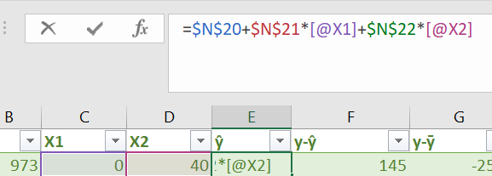
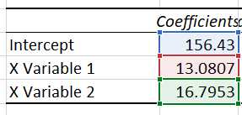
To calculate a prediction (called y-hat) we add the intercept to the variable values multiplied by their modifiers (coefficient)

Slide 12
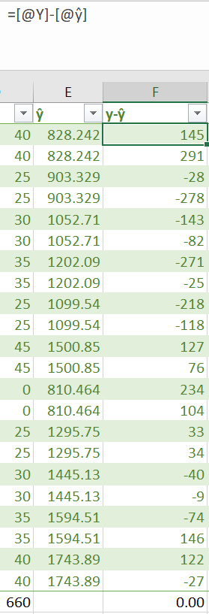
IF we take away the prediction (estimator) from the actual value we have the residual, or the size of the error. If this is too high, the error is positive, if the number is too low, the error is negative.
You might sometimes hear data scientists talking about residuals; these are the residuals.
It is simply the actual value minus the prediction.

Slide 13

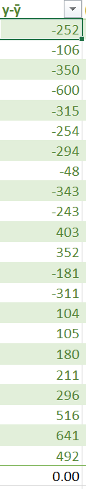
We can also measure the difference between the observed actual value and the average (mean) of the whole set of actuals.
This gives us a distance measure of variance, how far the actual varies from the average value of the actuals. This is a measure of the variance of the data.
If the number is bigger than average, the number is positive, if it is smaller than average, the number is negative.

Slide 14
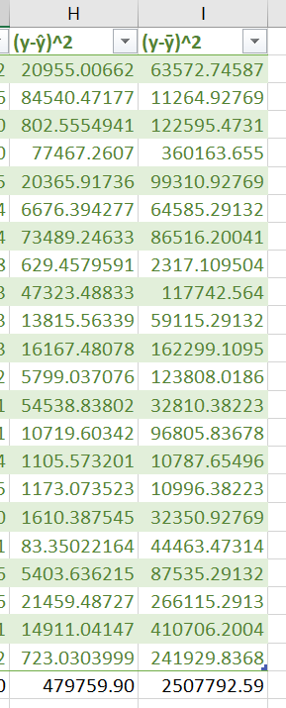


Both the size of the measures we just created have a sum of 0, because some values are bigger and some smaller than the actuals. This means when they get added up they cancel out to 0.
This is correct, but we are trying to compare the sizes of the errors, not whether they are above or below actual, so we need to lose the sign and make everything positive.
The way we’ll do that is by times-ing the number by itself (squaring the number), as -1*-1 = 1, -2 * -2 = 4 etc
Adding all these up across the set gives us the sums of squares

Slide 15
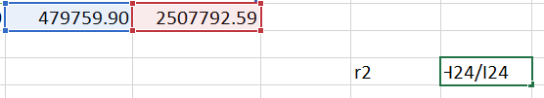


We then divide the sum of squares of our estimator error by the sum of squares of our distance from average. The estimator errors are always lower than the variance of the data, and we take the result from 1, to give us a value like 0.80, which we shouldn’t describe as 80% accurate, but you can think of it along these lines; 80% of variance is explained by the model.

Slide 16
Root Mean Squared Error
RMSE is the average of how far out we are on an estimation by estimation basis

Slide 17
How close to my line are my points on average?

Slide 18
How close to my line are my points on average?

Slide 19
A measure of the average broadness of the line

Slide 20
What does it tell us?
By comparing the average distance between the estimator ŷ and the observed actual, we can get a measure of how close in real world terms we are on average to the actual.
Unlike r² which gives an abstract view on variance, RMSE gives the bounds to the accuracy of our prediction.
On average, the real value is +/- RMSE from the estimator.

Slide 21
How do we calculate it?
It’s very easy and we’ve already done the hard work.
The MSE part means average of the squared distance of the estimator from the actual
=AVERAGE(data[(y-ŷ)^2])
Since the values were squared, this number is still big; square rooting this gives us a real world value.
=SQRT(AVERAGE(data[(y-ŷ)^2]))

Slide 22
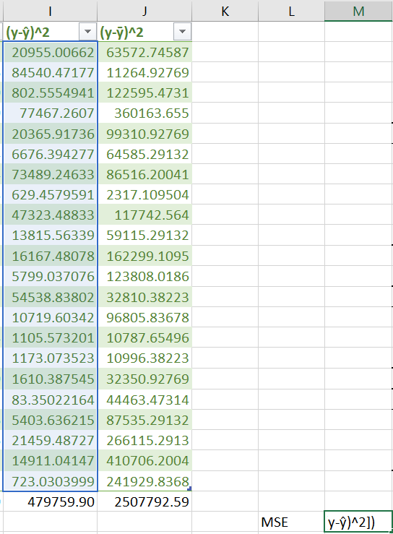

Take the average of the squared estimator distance from actual.
Squaring it earlier was useful, as the non-squared value averages out to zero!

Slide 23


Since the MSE is still in the order of magnitude of the Squares, square root it to give us a real world value and this is Root Mean Square Error (RMSE).
In this example, the estimate is on average 147.673 away from the actual value.

Slide 24
This model can therefore be described as: being able to describe 80% of variance being on average 147.6 away from the actual

